Slide 1

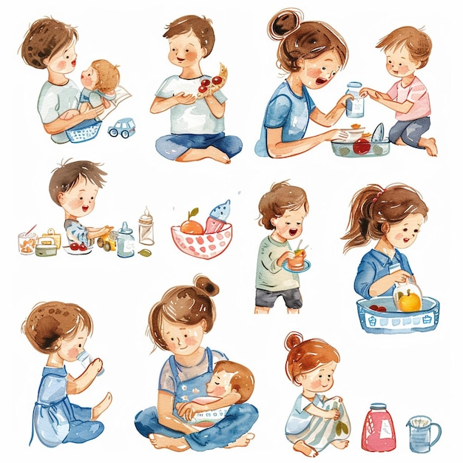
ChildCARE StuDY

Slide 2
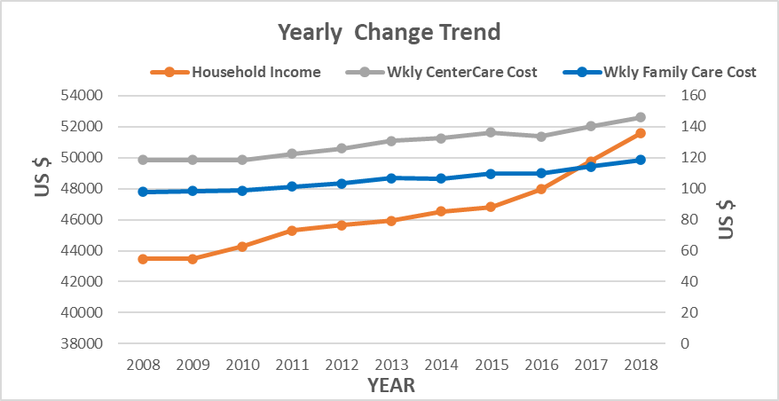
Nation wide Changes over years:
Nation wide, the income growth outpaced the daycare cost increase

Slide 3
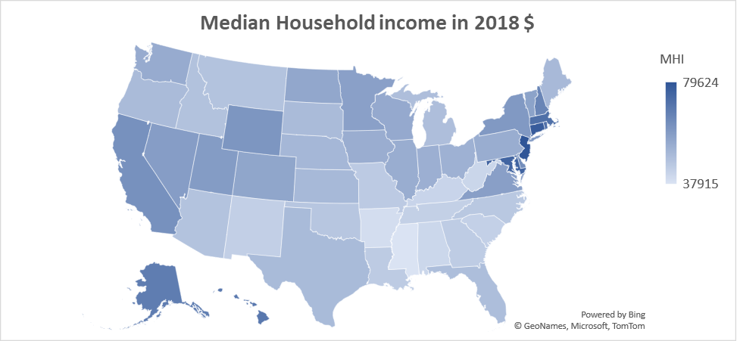

Texas household income is lower than nationwide average
National average: $54401
Texas: $49758

Slide 4
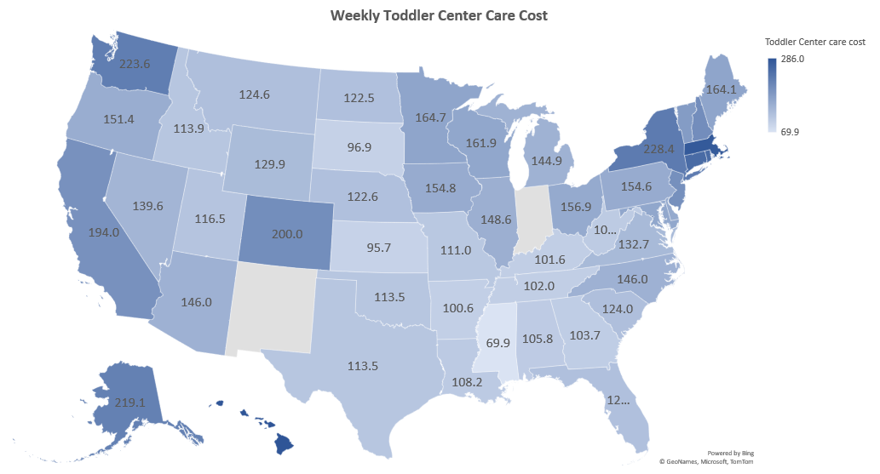
Texas childcare cost is lower than nationwide average
National average: $154
Texas: $113.5

Slide 5
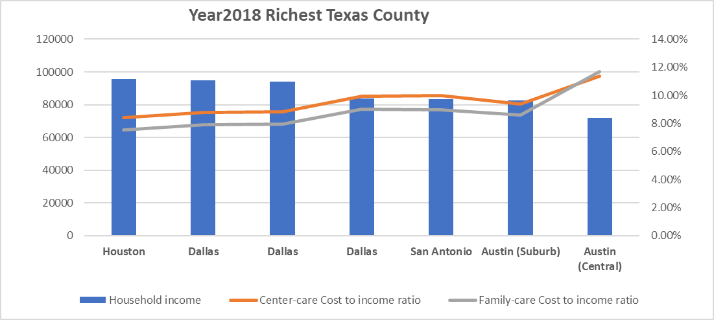
But: Central Austin area childcare cost is the MOST expensive in Texas, also well above Texas average ($113)!

Slide 6
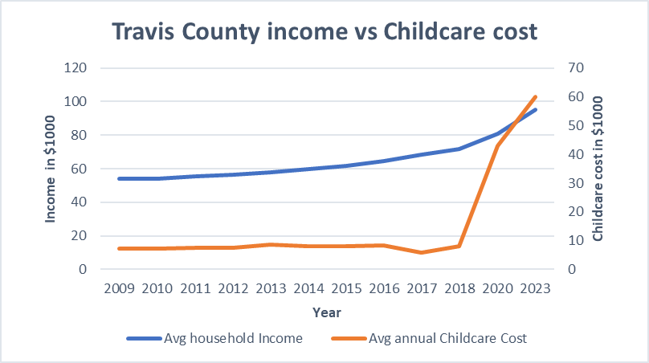
Travis County childcare cost increase outpaced the income growth since 2018

Slide 7
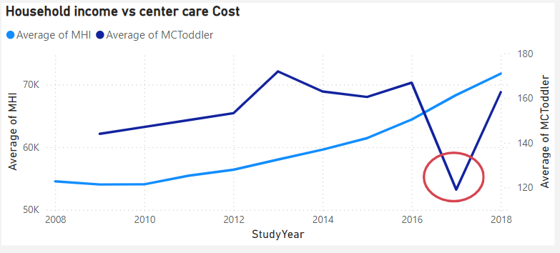
In 2017, policy change in Travis county helped to reduce the childcare cost
In 2017 only, City Council voted to minimize fee associated with Childcare startup cost and remove parking and permit restriction

Slide 8
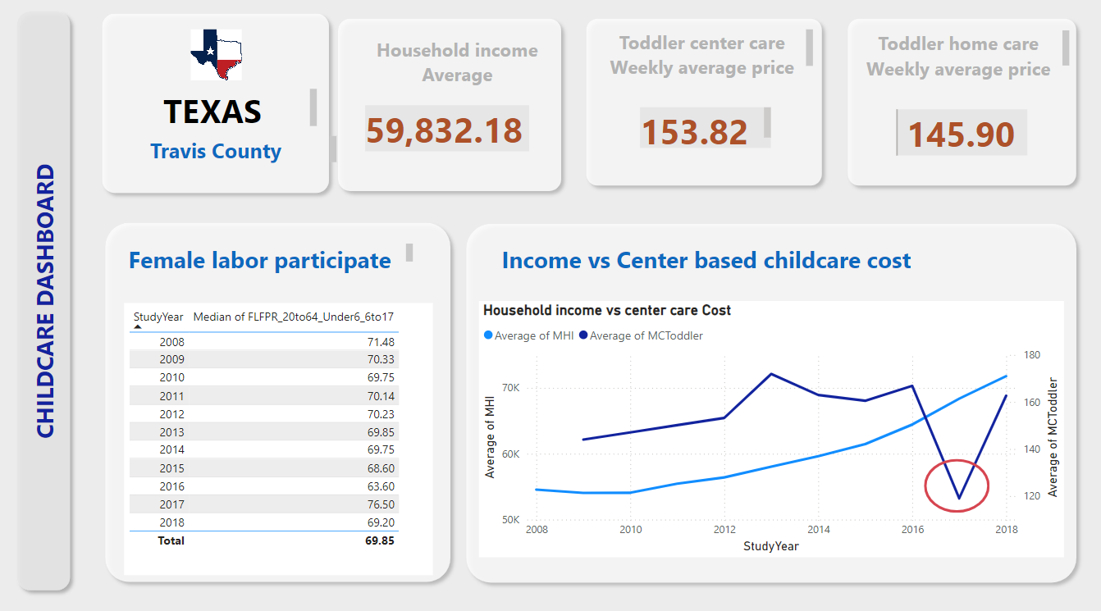
Medium 2: Dashboard:

Slide 9

Medium 3: Poster
support childcare bond

Slide 10
BACK UP

Slide 11
Medium selection and design decision
Design decision:
PowerPoint,
I focused on text size change to get attention on the one sentence summary, To make it very visible. I also place them at top of each slide and keep some space between chart and text. Color wise, I used an eye-friendly earth colored background and picked the blue color to get text stand out.
My intention is to give a story how cost at central Austin area is abnormal to Texas area, even more expensive than national average. My approach is to start with national level, get down to Texas level, finally zoom into central Austin area. To achieve this. I keep the national level map and chart less colorful. When it come to central Austin side, I try to make it more colorful and use more contrasting color.
I use circles and pointer a lot to get viewer attention to the locations I would like highlight.
Dashboard:
I try to highlight the numbers and make chart the focus area. So, I made the numbers more visible and use circle to point out the key moment in time. I did use the help from color difference (red on all key info) to achieve highlight.
Poster:
I assume my viewer only have few second to see it. So, I picked a mom/baby picture to highlight this is child relate, hopefully it will get more attention. I also used color different to bring out the action: vote for this!

